Slide 1
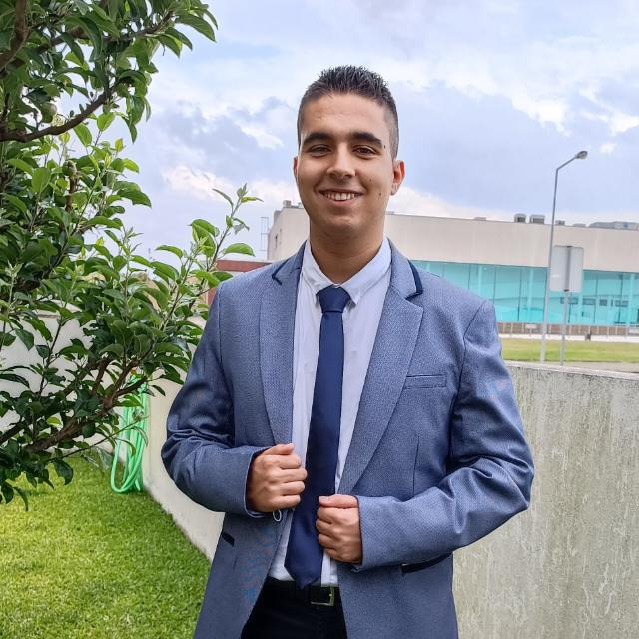

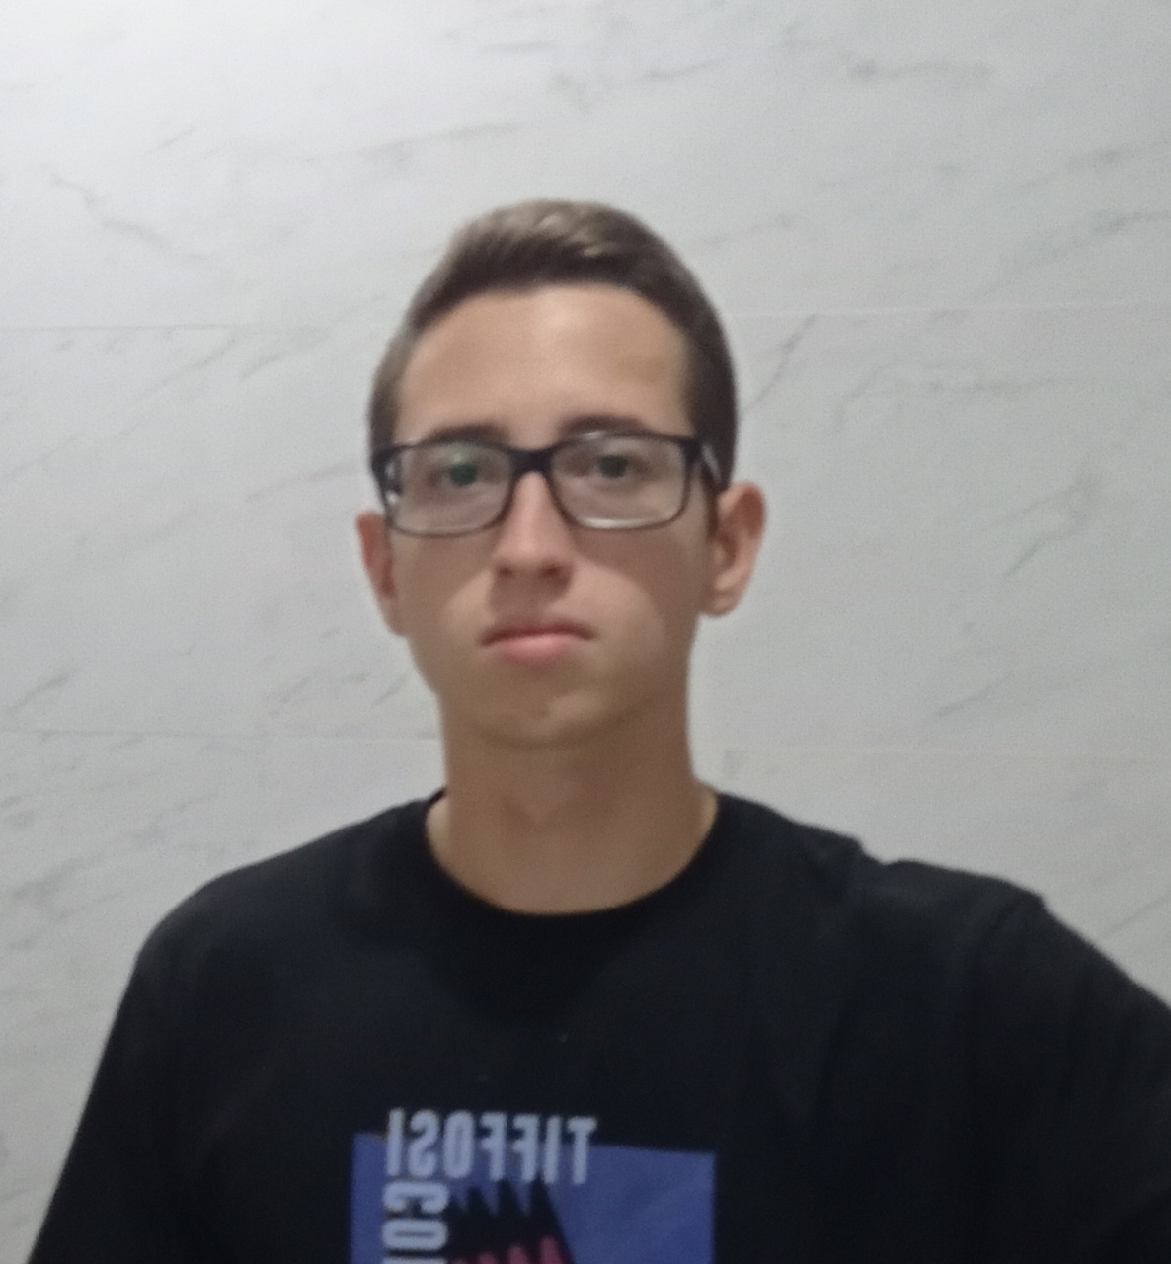
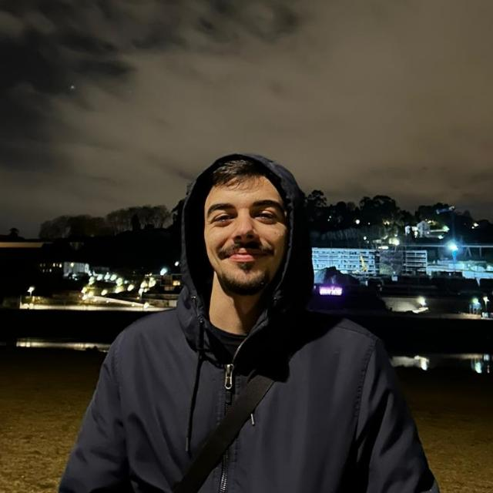
Class 2DI2DJ Group 094 SPRINT 1
LAPR3 2024_2025
Group members:
Diogo Veiros (1230462) | Diogo Pereira (1230948) | Tiago Sampaio (1230917) | Vicente Sousa (1211846)

Slide 2
Sprint planning – Sprint 1
Planned Start Date: 01/10 Real Start Date: 03/10
Planned Finished Date: 27/10 Real Finish Date: 27/10
SPRINT BACKLOG
Number of stories: 20
Number of bugs: 10
Number of tasks: 22
Number of Management Tasks (Scrum): 4
Number of team members 4 | Planned: 4 Actual: 4
Total planned estimation vs execution | Planned hours: 100 Executed hours: 120

Slide 3
Sprint planning
Assignment US (as stated on project assignment) | Commited? (Yes / no according to team planning) | Todo | Doing | Testing | Done | Blocked
USEI01 | YES |  |  |  | X
USEI02 | YES |  |  |  | X
USEI03 | YES |  |  |  | X
USEI04 | YES |  |  |  | X
USEI05 | YES |  |  |  | X
USEI06 | YES |  |  |  | X
USEI07 | YES |  |  |  | X
USEI08 | YES |  |  |  | X
USBD01 | YES |  |  |  | X
USBD02 | YES |  |  |  | X

Slide 4
Sprint planning
Assignment US (as stated on project assignment) | Commited? (Yes / no according to team planning) | Todo | Doing | Testing | Done | Blocked
USBD03 | YES |  |  |  | X
USBD04 | YES |  |  |  | X
USBD05 | YES |  |  |  | X
USBD06 | YES |  |  |  | X
USBD07 | YES |  |  |  | X
USBD08 | YES |  |  |  | X
USBD09 | NO |  |  |  |  | X
USLP01 | YES |  |  |  | X
USLP02 | YES |  |  |  | X
USLP03 | YES |  |  |  |  | X

Slide 5
Work by team member

Slide 6
Work by type

Slide 7
Issues / Assumptions / unanswered questions
Description | Responsible | Date / sprint | Related issue / item in Git
As an administrator, I want a data dictionary/glossary to be created, So that I can have a clear and organized reference of the terms and data structures used in the system. | 1230462 1230948 1230917 1211846 | SPRINT 1 | #21
As an Administrator, I want the relational model to be created at the logical level, So that I can have a structured representation of the system's data and its relationships, enabling efficient database design and management. | 1230462 1230948 1230917 1211846 | SPRINT 1 | #22
As an administrator, I want the relational model to be instantiated at the physical level, So that I can ensure the database is properly set up and ready for data storage and retrieval, allowing for efficient operations and management. | 1230462 1230948 1230917 1211846 | SPRINT 1 | #24

Slide 8
Issues / Assumptions / unanswered questions
Description | Responsible | Date / sprint | Related issue / item in Git
As a product owner, I want to import data from a legacy system, on a spreadsheet, and load it into the new system, So that I can ensure a smooth transition of data without loss of critical information, allowing the new system to function with the legacy data. | 1230462 1230948 1230917 1211846 | SPRINT 1 | #25
As a production manager, I want to know, for each product, the orders to be delivered (customer, product, quantity, date) within a given time frame, So that I can effectively plan and manage production schedules to meet delivery deadlines. | 1211846 | SPRINT 1 | #26
As a production manager, I want to know the types of workstations used in a given order, So that I can better understand the production process and optimize the allocation of resources and tasks. | 1230917 | SPRINT 1 | #27

Slide 9
Issues / Assumptions / unanswered questions
Description | Responsible | Date / sprint | Related issue / item in Git
As a production manager, I want to know the materials/components to be ordered to fulfill a given production order, including the quantity of each material/component, So that I can ensure that we have the necessary resources to complete the production on time and meet customer demands. | 1230948 | SPRINT 1 | #28
As a plant floor manager, I want to know the different operations the factory supports, So that I can effectively manage resources, allocate tasks, and ensure smooth production processes. | 1230462 | SPRINT 1 | #29
As an administrator, I want to define the adequate data structures to store the information imported from the files, So that the system can efficiently manage and process the imported data, ensuring data integrity and quick access. | 1230948 | SPRINT 1 | #31

Slide 10
Issues / Assumptions / unanswered questions
Description | Responsible | Date / sprint | Related issue / item in Git
As an administrator, I want to implement a simulator that processes all the items, So that I can efficiently manage the production workflow and ensure that all items are processed in a timely manner. | 1230462 | SPRINT 1 | #32
As an administrator, I want to calculate the total production time for the items, So that I can analyze production efficiency and identify any bottlenecks in the workflow. | 1230948 | SPRINT 1 | #33
As an administrator, I want to calculate execution times by each operation, So that I can evaluate the efficiency of each operation and identify opportunities for improvement in the production process. | 1230917 | SPRINT 1 | #34

Slide 11
Issues / Assumptions / unanswered questions
Description | Responsible | Date / sprint | Related issue / item in Git
As an administrator, I want to present a list of machines with total time of operation and percentages relative to the operation time and total execution time, sorted in ascending order of the percentage of execution time relative to the total time, So that I can identify which machines are the most efficient and make informed decisions regarding resource allocation and process improvement. | 1230917 | SPRINT 1 | #35
As an administrator, I want to present average execution times per operation and the corresponding waiting times, So that I can analyze the efficiency of each operation and identify areas for improvement in the production process. | 1211846 | SPRINT 1 | #36

Slide 12
Issues / Assumptions / unanswered questions
Description | Responsible | Date / sprint | Related issue / item in Git
As an administrator, I want to produce a listing representing the flow dependency between machines, So that I can analyze the relationships between machines in the production process and optimize workflows. | 1211846 | SPRINT 1 | #37
As an administrator, I want to consider an improvement to the simulator developed in USEI02 that takes into account a processing order based on priority, So that I can ensure that higher priority items are processed more quickly, leading to increased efficiency in the production workflow. | 1230462 | SPRINT 1 | #38

Slide 13
Issues / Assumptions / unanswered questions
Description | Responsible | Date / sprint | Related issue / item in Git
As a product owner, I want the domain model to be created at the conceptual level, So that I can have a clear and shared understanding of the system's structure, ensuring effective communication between stakeholders and developers. | 1230462 1230948 1230917 1211846 | SPRINT 1 | #23
As a product owner, I intend to present the simulation tools’ functionality and results through a user-friendly text-based interface, So that users can easily interact with the tools and understand the outcomes of the simulations without any technical barriers. | 1230462 1211846 | SPRINT 1 | #39

Slide 14
Issues / Assumptions / unanswered questions
Description | Responsible | Date / sprint | Related issue / item in Git
As a product owner, I want to visualize the product structure graphically for a given article, So that I can easily understand the relationships between components and ensure that the structure meets design specifications. | 1230948 1230917 | SPRINT 1 | #40
Complexity | 1230462 1230948 1230917 1211846 | SPRINT 1 | #47
Make the program run in the console | 1211846 | SPRINT 1 | #48
Normalize the Database | 1230462 1230948 1230917 1211846 | SPRINT 1 | #45

Slide 15
Issues / Assumptions / unanswered questions
Description | Responsible | Date / sprint | Related issue / item in Git
Create the Database tables | 1230462 1230948 1230917 1211846 | SPRINT 1 | #46

Slide 16
Daily Meetings
Date | Place / duration | Diogo Veiros | Diogo Pereira | Tiago Sampaio | Vicente Sousa
8/10/2024 | Class / 15 min | X | X | X
14/10/2024 | Online / 15 min | X | X | X
16/10/2024 | Online / 15 min | X |  | X
23/10/2024 | Online / 15 min | X | X | X
25/10/2024 | Online / 15 min | X | X
26/10/2024 | Online / 15 min | X | X | X | X

Slide 17
LLM performance assessment (chatGPT or Copilot)
Source file (include file as attachment):
Input (prompt) : “Give us your opinion on our planning and execution of this sprint, based on our sprint review. It also includes a brief line of feedback on the performance of each team member.”

Slide 18
LLM performance assessment
Output file (include file as attachment):
Output (one line per team member):
Diogo Veiros: Showed commitment and was consistent in his tasks, taking part in meetings, which indicates good communication and collaboration with the team.
Diogo Pereira: Contributed regularly and took responsibility for key tasks, showing good commitment to the sprint's objectives.
Tiago Sampaio: Performed solidly, taking on important tasks, especially in technical areas, helping the team to maintain the flow of work.
Vicente Sousa: Showed collaboration and was present at all critical meetings, reflecting good coordination and teamwork skills.
Overall, all the members were dedicated and worked to fulfil the planned objectives.
Opinion about the output:
According to the AI we had a dedicated and fulfilling first sprint which we are totally in accord with as we were able to finish everything that was planned for this sprint, but we do believe that there is always room to improve so we would have wanted something that looked to our errors.

Slide 19
Sprint Retrospective
Date: 27/10
What went well?
We finished all the Us’s and had a minimum viable product to show to the client.
What went wrong?
We were not able to add the professors to our repository and project.
What we’ve learned?
We learned how to make queries of different databases to get tables that would satisfy the client we were also able to understand how to use maps and other useful tools in the making of the project and be able to improve our ways of managing the work of the team.

Slide 20
Sprint Retrospective
Date: 27/10
Action items:
To minimize discrepancies between planned and executed hours, we aim to refine our time estimates by reviewing the actual time spent on similar tasks in previous sprints. This adjustment will help create a more realistic workload expectation and avoid excess hours beyond our initial plan.
Additionally, to improve task tracking, team members will commit to daily updates on their tasks’ progress through each development stage. By maintaining up-to-date status visibility, we can more quickly identify and resolve potential bottlenecks.
We also plan to increase the frequency of our sync meetings, scheduling an extra one per week. This adjustment will ensure stronger alignment among team members and allow us to address any issues sooner, thereby minimizing the impact on sprint goals.
By implementing these actions, we anticipate improvements in both productivity and the quality of our deliverables.

Slide 21

Overall Project performance:
Comments: We believe that we had a good start to the project with this 1st Sprint, but we also believe that there is room to improvement as there are things related to some parts of the project that could have been made better, but we can’t deny that this was a good Sprint for us.
- LLM evaluation: 😊 (Good)

Slide 22


